Slide 1




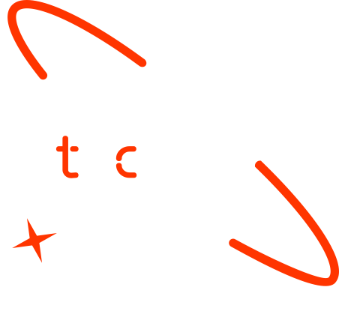

A new generation
of tech specialists

Slide 2
Energy Consumption
Prediction
Team Members: Omidjan Zazai Abdul Bari Rahimi

Slide 3
Outline
Concept note and implementation plan:​
Background​
Objectives​
SDG Relation​
Data​
Data Collection​
Exploratory Data Analysis (EDA) and Feature Engineering​
Model Selection and Training​
Model Evaluation and Hyperparameter Tuning​
Model Refinement and Testing​
Results​
Deployment​
Future Work

Slide 4
Background
Brief project overview​
The purpose of this project was to predict energy consumption using the data of Finland's transmission system.
Provide brief background​
exploring machine learning techniques and developing a data-driven model for forecasting energy.
Importance of the problem being solved
The result shows that electricity consumption can be predicted using machine learning algorithms so we can use the results to deploy renewable energy, plan for high/low load days, and reduce wastage from polluting on reserve standby generation.

Slide 5
Objectives
Clearly state the project objectives​
The objective of this project was to test if a machine learning model can yield good enough results in a complex forecasting problem, exploring machine learning techniques and developing a data-driven model for forecasting energy.
Outline what the machine learning model aims to achieve
The result shows that electricity consumption can be predicted using machine learning algorithms so we can use the results to deploy renewable energy, plan for high/low load days, and reduce wastage from polluting on reserve standby generation.

Slide 6
SDG Relation
Provide how your project is related with SDGs
This project aligns with several Sustainable Development Goals (SDGs), particularly SDG 7 (Affordable and Clean Energy), SDG 9 (Industry, Innovation, and Infrastructure), SDG 11 (Sustainable Cities and Communities), and SDG 13 (Climate Action). By using machine learning (LSTM) to predict energy consumption, the research contributes to more efficient energy management, reducing waste and optimizing renewable energy integration. Accurate forecasting helps in planning for high and low energy demand, preventing unnecessary standby generation from fossil fuels, thereby lowering carbon emissions. Additionally, it supports the development of smart energy grids, promoting innovation in infrastructure and sustainable urban energy planning. Ultimately, this project aids in the transition towards a more sustainable and environmentally friendly energy system.

Slide 7
Data

Slide 8
Data
Source(s) of the dataset​
The dataset used in this project comes from Finland's transmission system operator. In Finland, the main transmission system operator (TSO) is Fingrid Oyj, which is responsible for balancing electricity supply and demand in the national grid.
Preprocessing steps during data collection​
I just downloaded the data from Fingrid Open Data
Handling missing values, outliers, etc.
During data preprocessing, missing values were checked, and since none were found, no imputation was needed. However, if present, techniques like forward-fill, mean imputation, or interpolation could be applied. Time series anomalies, such as missing timestamps or sudden spikes, were handled through resampling, smoothing, or seasonal adjustments to ensure data consistency. These steps improved data quality, making it suitable for training the LSTM model effectively.

Slide 9
Model

Slide 10
Model Selection and Training/Testing
Details on training the model​
The LSTM model was trained to predict energy consumption using a preprocessed time series dataset. The data was normalized and split into training and validation sets, with sequences created to capture patterns. The model architecture included LSTM layers, dropout layers to prevent overfitting, and dense layers for final predictions. Training was conducted over 60 epochs with a batch size of 20, using the Adam optimizer and Mean Squared Error (MSE) as the loss function.
Hyperparameters used and any cross-validation techniques​ and details on any hyperparameter tuning
Performance was evaluated using Root Mean Squared Error (RMSE), demonstrating that machine learning can effectively forecast energy consumption, aiding in better energy management and sustainability.
Please provide comparison of models
LSTM was chosen for this project because it excels at capturing sequential patterns in energy consumption data, especially with seasonal trends and long-term dependencies. While models like ARIMA work well for stationary data, LSTM can handle non-linearity and dynamic changes better, making it more suitable for forecasting energy demand over time.
Visualization
Visualization is important for our model, we have prepared different visualization for our model.

Slide 11
Result

Slide 12
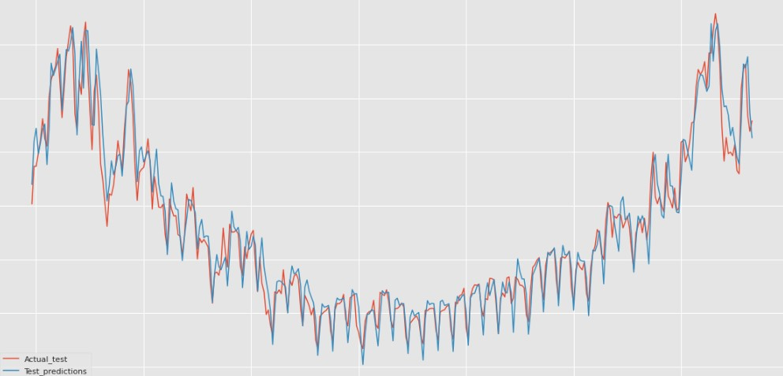
Evaluation Results
Showcase the results of your project here.

Slide 13
Deployment

Slide 14
Deployment
Overview of the deployment phase​
The deployment phase of the energy consumption prediction model focuses on integrating the trained machine learning model into real-world applications. Once the model is trained and evaluated, it can be deployed to forecast energy consumption in real-time or for future periods
Despite the challenges, the deployment phase can be revisited once data quality improves and modern energy infrastructure is in place. In the meantime, collaborating with local authorities to improve data collection processes or pilot projects in specific regions could be a possible approach for future implementation.
Model serialization, serving, and API integration​
Once deployment stage is done we can then do many more with the model like integrating API, and different kind of serving.

Slide 15
Conclusion and Futurework
For now the model is prepared and working for future stage we will do our best to discuses this with authorities for better data collection and infrastructures for this model to build it as a real work project.

Slide 16


Thank you!

